Slide 1


Distributed Erlang Workshop
Github.com/AustinErlang
Wireless Access
SSID: AustinErlang
WPA2 Pass: Erlang#$
@austinerlang

Slide 2

Agenda
Vagrant Check
Actor Model
Erlang Web Framework
Benefits of Distribution
Distributed Erlang
Security
RPC
Tutorial

Slide 3
Erlang Setup
Vagrant | git clone https://github.com/AustinErlang/DistributedErlang cd DistributedErlang vagrant up (you will see a prompt for bridge interface selection. Use WIFI) vagrant ssh

Slide 4
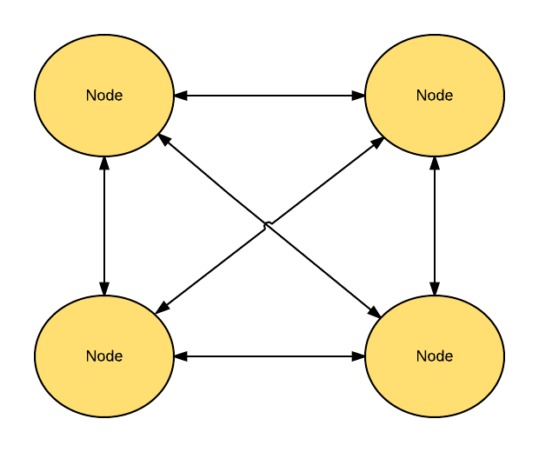
Default Distribution Topology
Full Mesh

Slide 5
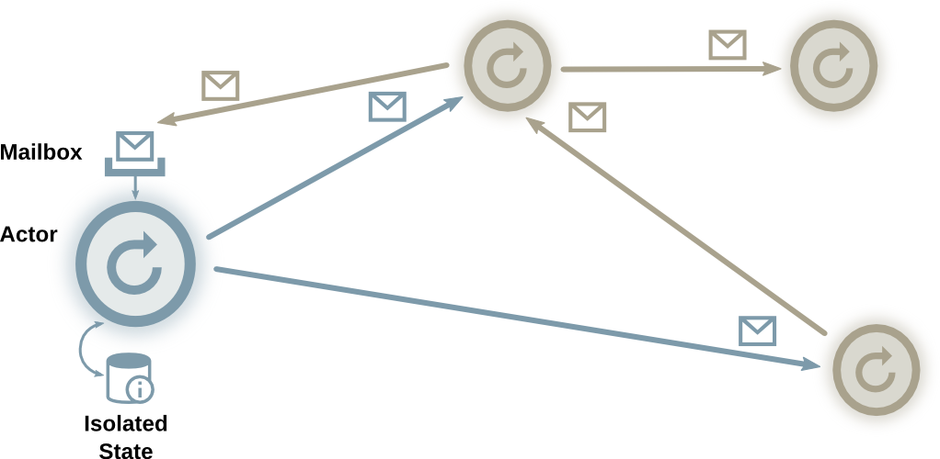
Actor Model
Notes:
The actor model in computer science is a mathematical model of concurrent computation that treats "actors" as the universal primitives of concurrent computation: in response to a message that it receives, an actor can make local decisions, create more actors, send more messages, and determine how to respond to the next message received.

Slide 6
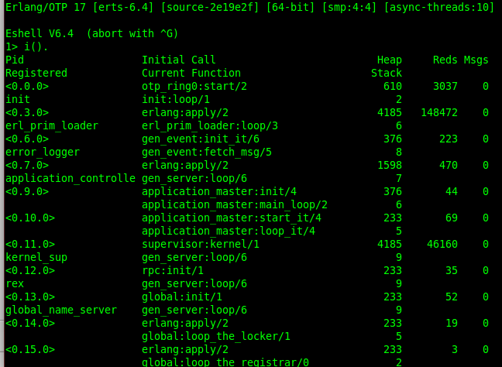
Process ID Format: <A,B,C>
Field | Meaning
A | Node id. It is the atom slot integer for the node name. 0 is Local
B | Process index which refers to the internal index in the proctab, (0 -> MAXPROCS)
C | Serial which increases every time MAXPROCS has been reached

Slide 7
Mailbox
Every process has a mailbox (including the REPL)
receive to pull messages
flush() to empty the mailbox
<PID> ! Msg
Asynchronous
ref()
> process_info(self()).
[{current_function,{erl_eval,do_apply,6}},
{initial_call,{erlang,apply,2}},
{status,running},
{message_queue_len,2},
{messages,[hi,hi2]},
{links,[<0.27.0>]},
{dictionary,[]},
{trap_exit,false},
{error_handler,error_handler},
{priority,normal},
{group_leader,<0.26.0>},
{total_heap_size,13544},
{heap_size,6772},
{stack_size,24},
{reductions,25062},
{garbage_collection,
...

Slide 8
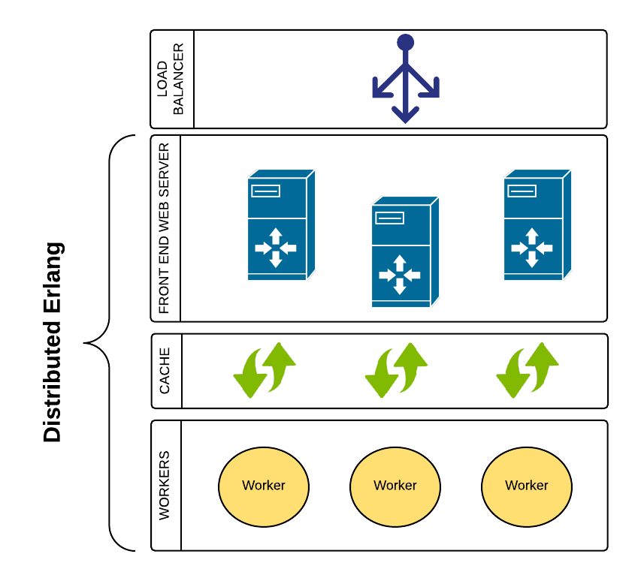
Erlang Web Framework

Slide 9
Benefits of Distribution
Performance that scales with demand, extensible
Fault tolerance with replication
Federation of disparate services
Erlang makes distributed computing much easier
  epmd
  no shared state
  messaging
  OTP
  supervisors
  heterogeneous hardware

Slide 10
Distributed Erlang Basics
A node is just an Erlang VM on a host
  erl -sname NodeName
  erl -name NodeName@address
Any node can connect to another
EPMD (Erlang Port Mapper Daemon) port 4369
Hosts can have multiple nodes
As soon as a node is referred to it is connected
  net_adm:ping(NodeName)

Slide 11
Distributed Erlang Basic Functions
node() identifies yourself
self() identifies your process id
nodes() to see a list of connected nodes
spawn/4 to run a function on a node
erlang:is_alive() checks your ability to join a cluster
net_kernel controls erlang's distributed operations
code isn't automatically propagated

Slide 12
Workshop
Starting your erlang node
Create a triangular number function
Making it into a registered service on your node
Send / Receive messages locally
Cluster your nodes together
Make remote calls
Handle failures
Distribute tasks across the cluster

Slide 13
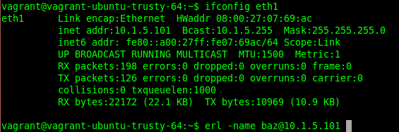
Starting Your Node
erl -name name@ipaddress -setcookie austinerlang
but

Slide 14
Create Factorial Function
Create a module named triangular.erl
Match the name with -module(triangular).
Export all functions
Compile: c(triangular).
  {ok,triangular}
Call triangular:calc(12).
  78
-module(triangular).
-compile(export_all).
calc(0) -> 0;
calc(N) when N > 0 ->
N + calc(N - 1).

Slide 15
Make it a process
Create a recursive loop that will block on receive
c(triangular).
Pid = spawn(triangular, facLoop, []).
Pid ! {self(), 4}.
flush().
  Shell got {ok,24}
triLoop() ->
receive
{Pid, N} ->
Pid ! {ok, calc(N)}
end,
triLoop().

Slide 16
Send it incorrect messages
Pid ! hi.
flush() will reveal no messages as expected
Send more: Pid ! 52. Pid ! {22}
process_info(Pid, messages).
  {messages,[hi,52,{22}]}
Unmatched messages will stay in the mailbox forever.
Selective Receive!
triLoop() ->
receive
{Pid, N} ->
Pid ! {ok, calc(N)}
end,
triLoop().

Slide 17
Discard bad messages
Keep the message queue clean with underscore match all
c(triangular). then restart shell, ctrl-c d or q().
Test again:
  Pid = spawn(triangular, facLoop, []).
  Pid ! 52. Pid ! {22}
process_info(Pid, messages).
  {messages,[]}
Treat bad messages as bugs!
Consider Logging Them
receive
{Pid, N} ->
Pid ! {ok, calc(N)};
_ -> unknown
end,
triLoop().

Slide 18
Exit the loop
Why did we have to exit the shell to kill the process?
Add a pattern matcher to handle exits.
c(triangular). and then restart shell.
Pid = spawn(triangular, facLoop, []).
process_info(Pid).
Pid ! exit.
process_info(Pid).
  undefined
Pid ! hello.
No error? Async doesn't care
receive
{Pid, N} ->
Pid ! {ok, calc(N)};
exit ->
exit(normal);
_ ->
unknown
end,

Slide 19
Registered Processes
Registered services are named processes.
Sending a message to a non-existent service will error.
someservice ! hi.
** exception error: bad argument
in operator !/2
called as service ! hi

Slide 20
register/2
Add an init/0 function to register your process
Add a start/0 to spawn for you
?MODULE is a macro for your module name
register(SERVICENAME, PID).
  Note the self() PID will be the spawned pid.
Pid = whereis(factorial).
process_info(Pid).
start() ->
spawn(?MODULE, init, []).
init() ->
register(triserve, self()),
triLoop().

Slide 21
Create a RPC function
Start calling the triangular service on other nodes!
Connect with net_adm:ping(Node).
nodes().
-module(remote).
-compile(export_all).
call(Pid, Node, Message) ->
{Pid, Node} ! {self(), Message},
receive
{ok, Res} ->
Res
end.

Slide 22
Timeouts
What if the process crashes?
Add a timeout. Timeouts are in milliseconds.
call(Pid, Node, Message) ->
{Pid, Node} ! {self(), Message},
receive
{ok, Res} ->
Res
after 1000 ->
{error, timeout}
end.

Slide 23
Monitors
One way monitors that notify you if the node dies
call(Pid, Node, Message) ->
monitor_node(Node, true),
{Pid, Node} ! {self(), Message},
receive
{ok, Res} ->
monitor_node(Node, false),
Res;
{nodedown, Node} ->
{error, node_down}
after 1000 ->
{error, timeout}
end.

Slide 24

Really?
This is getting messy ...

Slide 25
RPC Module
rpc:server_call(Node, Name, ReplyWrapper, Msg) ->
Reply | {error, Reason}
Update triangular:triLoop/0
rpc:server_call('foo@172.16.1.2', triserve, ok, 200).
receive
{Pid, N} ->
Pid ! {ok, node(), calc(N)};
exit ->
exit(normal);
_ ->
unknown
end,
triLoop().

Slide 26
RPC and Code Loading
call(Node, Module, Function, Args, Timeout) ->
Res | {badrpc, Reason}
Load code across the cluster!
  {Mod, Bin, Filename} = code:get_object_code(Mod),
  rpc:multicall(code, load_binary, [Mod, Filename, Bin]).

Slide 27

Distributing Requests
Routing methods
Round Robin
Random
Cost Based
By Service / Task Type
Profiling (time)
cluster.erl:
  connect/0
  seed/0
  rand/0
  dist_random/1
  dist_rr/1
  count_messages/0
  count_flush/0

Slide 28
Security
Cookies
  erl -sname NodeName -cookie ScalabilityIsAwesome
Use SSL over TCP/IP for non-secure networks
Rewrite net_kernel

Slide 29
Alternative Topologies
erl -sname node_name -hidden
net_kernel:connect(NodeName)
test locally with docker

Slide 30






Erlang Community & Resources
Github
erlangcentral.org
erlang.org
erlang-solutions.com
#erlang on Freenode
erlang-questions@erlang.org

Slide 31


Acknowledgements
Erlang Programming by Francesco Cesarini and Simon Thompson
conference space @ 303 Colorado St.

